Slide 1
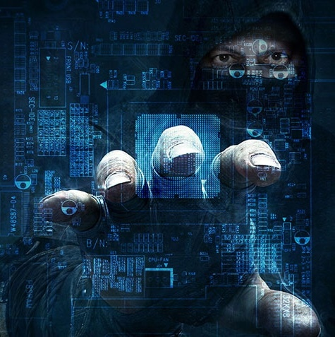





Virginia Cyber Alliance
Professional Workshop Series
Cyber Crime
June 21, 2019
11:30am – 2:30pm
Old Dominion University
Virginia Modeling, Analysis, and Simulation Center
1030 University Blvd, Suffolk, VA 23435
RSVP – jcostanz@odu.edu
Special guest speakers
Darren Spencer,
Digital Forensic Examiner
Clifton Everton, III
Special Agent in Charge
Darrius Davenport,
Cybersecurity & Data Privacy Law

Slide 2

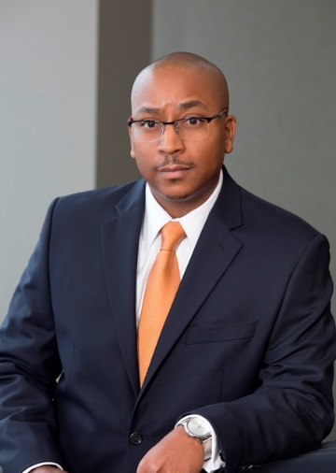

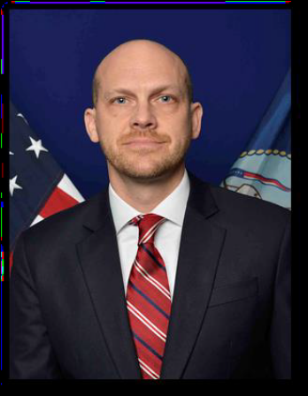

Speakers
Darius K. Davenport, Esquire
Darius is a partner and Chairman of the Cybersecurity and Data Privacy Practice Group of Crenshaw, Ware & Martin. His practice focuses on data privacy laws and regulations, helping clients mitigate cyber risk, and dealing with the legal and practical problems resulting from cyber incidents. His cybersecurity counsel to businesses and municipalities includes drafting and review of incident response plans, cybersecurity employee policies, technology contracts and conducting cybersecurity and breach response exercises. He is frequently invited to speak on cybersecurity and data privacy issues. Mr. Davenport’s practice also includes complex litigation in state and federal courts with an emphasis on public sector law, employment law and insurance defense. He represents housing authorities, businesses and municipalities across the region. Mr. Davenport has extensive experience developing, drafting and interpreting government regulations and policies. As a former U.S. Army JAG attorney, he has provided legal advice and counsel to senior government officials on a wide variety of legal issues.
Clifton Everton, III, Special Agent in Charge
Clifton J. Everton, III reported as the Special Agent in Charge of the Naval Criminal Investigative Service (NCIS) Norfolk Field Office in June 2017. He is responsible for the management and operational direction of NCIS offices throughout Virginia.
Special Agent Everton previously served as the Special Agent in Charge of the NCIS Middle East Field Office where he was responsible for the management and operational direction of NCIS offices throughout Southwest Asia and East Africa.
Special Agent Everton began his career with NCIS in 1999 with the Northwest Field Office. He subsequently served in a variety of organizational assignments and mission areas domestically and abroad. Those assignments included NCIS Resident Agency Sigonella, Italy, NCIS Headquarters and a deployment to Baghdad, Iraq in support of Operation Iraqi Freedom. Special Agent Everton holds a Master of Arts degree in Security Management from Webster University, St. Louis, Missouri, and a Bachelor of Arts degree in Government from the College of William and Mary, Williamsburg, Virginia. Awards and recognitions include the DOD Joint Civilian Service Achievement Award, National Counterintelligence and Security Center (NCSC) Investigations and CI Collections awards and the DOD Global War on Terrorism medal.
Darren Spencer, Digital Forensics Examiner
As an FBI Digital Forensics Examiner, Darren examines all digital devices that may hold evidence and could be used in a court of law. He often works on cases involving offenses committed on the Internet, also known as cyber-crimes, and examines digital devices that may have been involved in other types of crime to find evidence of illegal activity. He assists law enforcement at the local, state, and federal levels as well as intelligence officials to analyze data and evaluate its relevance to the case under investigation. He is also in the FBI Forensics Audio Video Program (FAVP) and manages the budget and day to day operations of the FBI’s Digital Forensics Lab. Darren is an Adjunct faculty and teaches cyber related courses at the FBI Academy in Quantico. He also teaches bachelor and masters level curriculum in Cyber Security certified by the National Security Telecommunications and Information Systems Security (NSTISS) and the NSA. Darren holds a B.S. in Computer Information Systems from Bellevue University in Bellevue, NE and a M.B.A. with concentration in Computer and Information Security from North Central University in Prescott, AZ.

